Slide 1
TYMPANIC CAVITY
BY
DR. OGWUCHE, ELIJAH
(BSc. MSc. MB,BS)
LAGOS STATE UNIVERSITY COLLEGE OF MEDICINE (LASUCOM), IKEJA.

Slide 2
OUTLINE
INTRODUCTION
BOUNDARIES
COMMUNICATION
CONTENTS
BLOOD SUPPLY
LYMPH DRAINAGE
NERVE SUPPLY
FUNCTIONS
APPLIED ANATOMY
REFERENCES

Slide 3
INTRODUCTION
The tympanic cavity (middle ear); Is the narrow slip-like cavity in the petrous part of the temporal bone
It extends from the tympanic membrane to the lateral wall of the inner ear

Slide 4
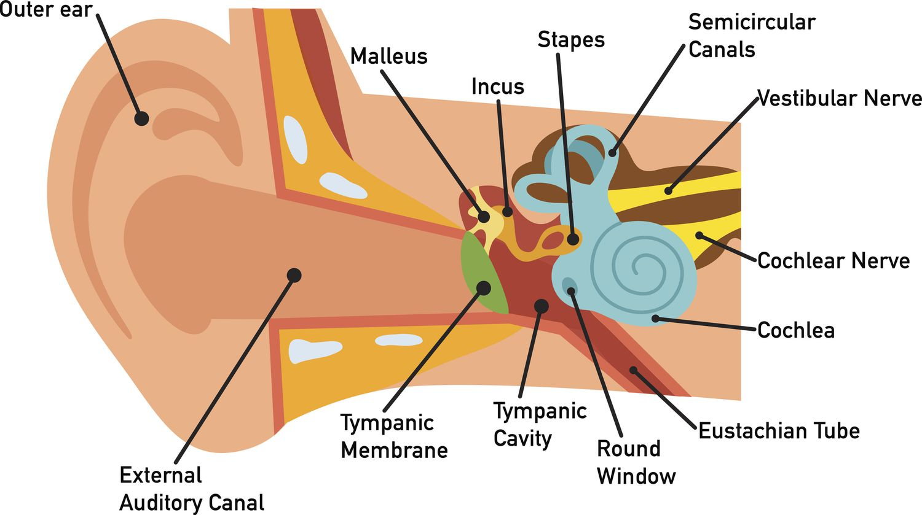
DIAGRAM

Slide 5
BOUNDARIES
The tympanic cavity is more like a rectangular cavity with six (6) borders or walls, namely; Anterior wall, Posterior wall, Medial wall, Lateral wall, Floor and Roof.
Anterior (Carotid) wall; it is narrow, formed by a thin bony plate that seperates the middle ear from internal carotid artery.
-it has two openings that leads into the auditory tube and tensor
tensor tympani muscle
Posterior (mastoid) wall; formed by a bony partition and mastoid air cells
-superiorly; aditus, fossa incudus, pyramid, posterior canaliculus for the chorda tympani

Slide 6
BOUNDARIES Cont’d
Medial wall; formed by the fenestra cochlea, fenestra vestibuli and the
promontory (a prominent bulge produced by the facial nerve)
It is the lateral wall of the inner ear
Lateral wall; the tympanic membrane and lateral wall of the epitympanic recess
Floor (jugular wall); Formed by a thin plate of bone separating the
tympanic cavity from the bulb of internal jugular vein (IJV)
Roof ; formed by the tegmen tympani which is a thin sheeth of bone
that seperates the middle ear from the middle cranial fossa

Slide 7
COMMUNICATIONS
Anteriorly; the tympanic cavity communicate with the pharynx through the pharyngotympanic tube
Posteriorly; it communicates with the mastoid antrum and mastoid air cells

Slide 8
CONTENTS
It contains the following structures;
Auditory ossicles; Malleus, Incus and Stapes
Stapedius and tensor tympani muscle
Tympanic plexus of nerves formed by fibres of facial nerve and
glossopharyngeal nerve

Slide 9
BLOOD SUPPLY
Anterior tympani artery, a branch of the maxillary artery
Stylomastoid artery, from the posterior auricular artery
Superior tympanic artery, a branch of Middle meningeal artery
Veinous drainage; Drains into the pterygoid plexus of veins
Lymphatic drainage; lymph drains into the parotid, retropharyngeal
and upper deep cervical lymph nodes

Slide 10
NERVE SUPPLY
The middle ear is supplied by branches of the trigeminal nerve, facial nerve, glossopharyngeal nerve and vagus nerve
The mucous membrane is supplied by branches of the tympanic plexus formed mainly by the tympanic branch of glossopharyngeal
(Jacobson’s) nerve

Slide 11
FUNCTIONS
Transmission of sound wave from the external ear (tympanic membrane) to the inner ear through the auditory ossicles
It increases the intensity of sound waves (10 times)
Sound waves causes the tympanic membrane to vibrate, which then causes the ossicles to move.
This mechanical motion is transferred through the middle ear to the inner ear, where it is converted into electrical signals for the brain to interpret

Slide 12
APPLIED ANATOMY
Otitis media; inflammation of the middle ear, this may result from spread of infection from the throat via the auditory tube to the middle ear
From the middle ear, the infection can spread to the mastoid air cells
Infection of the mastoid process can spread to the middle cranial fossa, then into the brain and cause inflammation of the meninges
Fracture of the middle cranial fossa, breaks the roof of the middle ear, rupture the tympanic membrane and cause bleeding via the ear and discharge of cerebrospinal fluid (CSF)
Mastoiditis; inflammation of the mastoid process with pus formation should be drained and care must be taken not to damage facial nerve
Hyperacusis; decreased sound tolerance due to paralysis of stapedius muscle

Slide 13
REFERENCES
Cotran, Ramzi S, Vinay Kumar, and Stanley L Robbins: Pathologic Basis Of Disease. 9th ed. Philadelphia, PA: Saunders Elsevier, 2015. Print.
Netter, Frank: Atlas Of Human Anatomy. 6th ed. Philadelphia, PA: Elsevier, 2014. Print.
'Notes & Querries': Scientific American 50.14 (1884): 218. Web. 30 May 2015.
Sinnatamby, Chummy S, and R. J Last. Last's Anatomy: 12th ed. Edinburgh: Churchill Livingstone/Elsevier, 2011. Print.
Snow, James B, John Jacob Ballenger, and James B Snow: Ballenger's Otorhinolaryngology. 16th ed. Hamilton, Ont.: BC Decker, 2003. Print.
Standring, Susan, Neil R Borley, and Henry Gray. Gray's Anatomy: The Anatomical Basis Of Clinical Practice. 40th ed. [Edinburgh]: Churchill Livingstone/Elsevier, 2008. Print.

Slide 15
THANK YOU ALL FOR LISTENING

